Slide 1
Netflix Viewership Analysis
Analyzing the content distribution strategy of OTT Platforms
- Shreya Asthana

Slide 2
Introduction
Analyzed 24,812 records of Netflix content (2023) to identify trends in viewership patterns.
Cleaned and preprocessed missing data, ensuring accurate insights using Pandas and NumPy
Explored the impact of release dates, language, and content type on audience engagement.
Created visualizations to showcase viewership trends by season, content type, and global availability.
Objective
Analyze Netflix viewership patterns to identify key trends and insights.
Tools & Technologies Used
Python, Pandas, Matplotlib, Seaborn

Slide 3
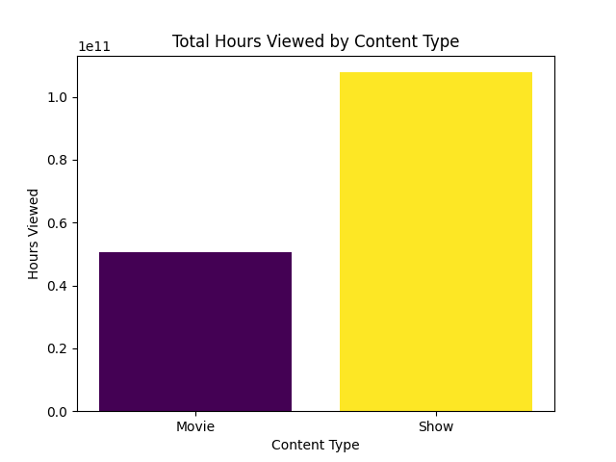
Key findings
TV shows are watched more than movies, suggesting that users prefer long-form content or binge-watching series.

Slide 4
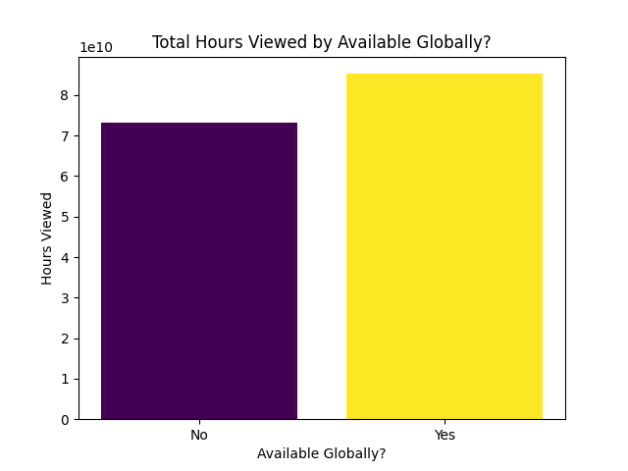
Key findings
Shows and movies that are available worldwide have higher total hours viewed compared to those with limited regional availability.
The difference is significant but not extreme, meaning even regionally restricted content still attracts substantial viewership.

Slide 5
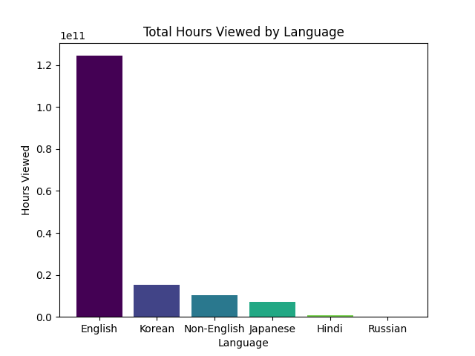
Key findings
English-language content has the highest total hours viewed, significantly surpassing all other languages.
The difference is massive, making English the primary language for streaming consumption

Slide 6
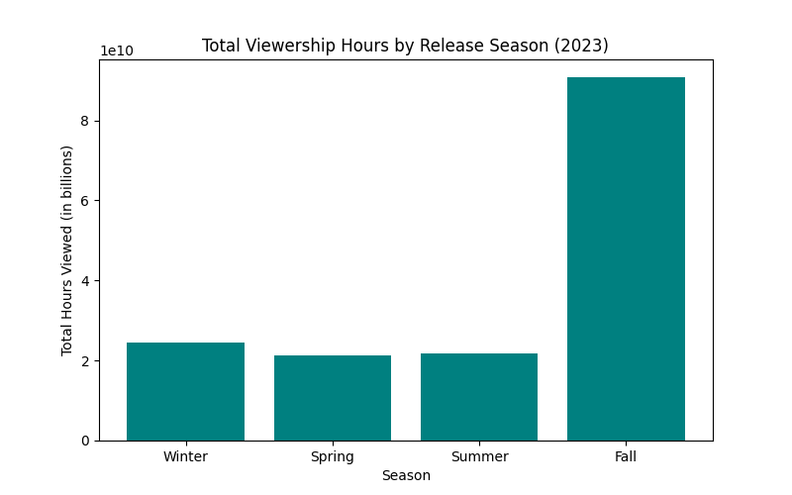
Key findings
Content released in Fall has the highest total viewership hours compared to other seasons.
This can be due to Major Holiday Season Impact (Thanksgiving, Black Friday, pre-Christmas binge-watching).

Slide 7
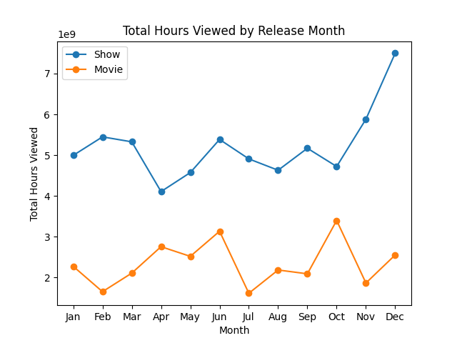
Key findings
There is a significant peak in December, likely due to the holiday season (Christmas & New Year), when people have more free time to watch content.
Movie viewership is more volatile, with noticeable peaks in March, June, and October. These could be due to major movie releases or seasonal trends.
June and October also show increased viewership, possibly due to summer vacations and Halloween-related content.

Slide 8
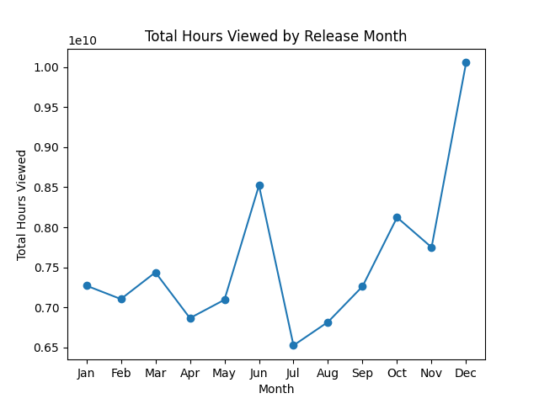
Key findings
The viewership gradually increases toward the end of the year, with December standing out as the top-performing month.
Periodic fluctuations suggest that seasonality affects content consumption patterns significantly

Slide 9
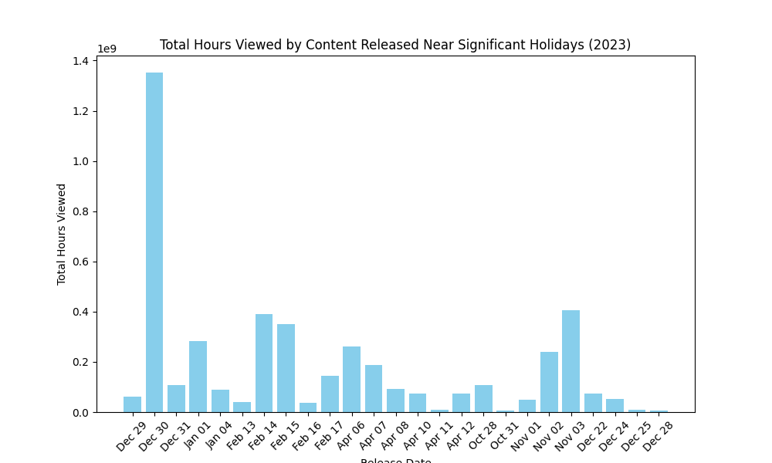
Key findings
New Year’s Eve recorded the highest viewership,
indicating a strong preference for entertainment during major holidays.

Slide 10
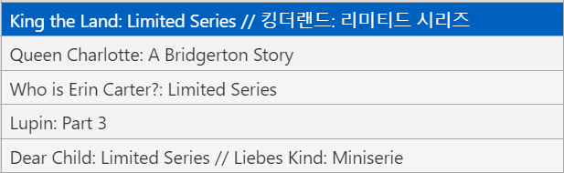
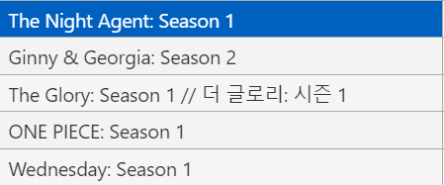
Top 5 Most Watched Content
Movies
Shows

Slide 11
Conclusion
Content released in the Fall season attracts the most viewers, with December being the peak month.
English-language content dominates streaming platforms, whereas non-English content has a smaller but noticeable audience.
Seasonal and monthly variations strongly influence viewership, with major peaks in December, June, and October.

